Slide 1
PROJECT
GALLIMO STUDIO(GALLARY & EMOJI STUDIO)

Slide 2
Overview:
INTRODUCTION TO GALLERY & EMOJI STUDIO:-
(Likely a combination of two application)
A gallery studio is an application designed to help users browse, organize, and manage their photo and video collections on their smartphones or tablets. It provides a user-friendly interface to access media files stored on the device.
An emoji application that enables users to design their own emojis. Users can either start from scratch or use templates and customize them with different colors, shapes, and features.

Slide 3
Software Requirement
Development Environment:
Android Studio
Java Development Kit (JDK)
Operating System:
Android Studio is compatible
SDKs and Tools:
Android SDK
Emulators or Real Devices
Backend
Version Control
Dependencies and Libraries

Slide 4
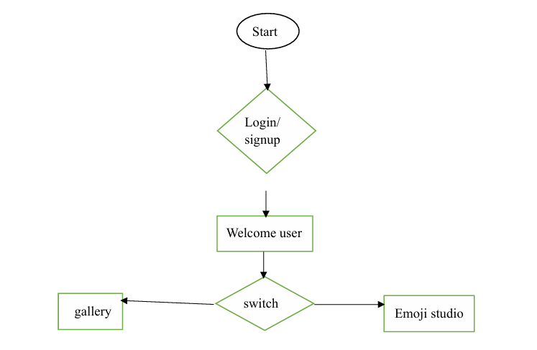
Application Flow

Slide 5
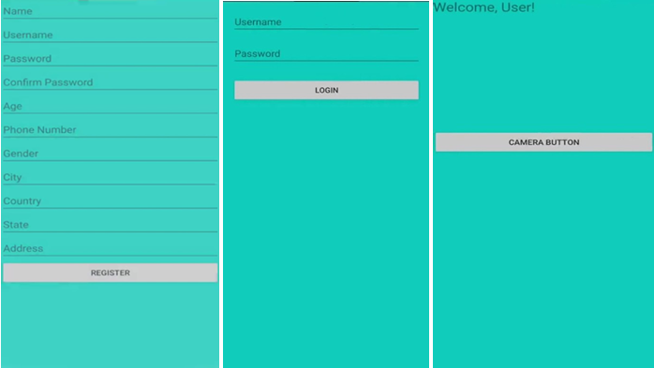
SCREENSHOTS OF DEVELOPMENT PHASE

Slide 6
FEATURES to edit:-
(Features that could be in GALLIMO):
FOR GALLERY |  | FOR EMOJI
crop | Create album,etc. | Design
Effects |  | Draw
Draw |  | Tools
Enhance |  | Text & creativity

Slide 7
Features:-
Image Grid View:
Display images from device storage in a grid layout using GridView or RecyclerView.
Image Viewer:
Tap an image to open it in full-screen view.
Image Selection:
Select multiple images for sharing or deletion.
Share Images:
Share images via social media, email, or messaging apps.
Dynamic Loading:
Images are loaded dynamically from storage to avoid memory overload.
Search Functionality:
Filter images by name or file type.

Slide 8
Features for emoji maker:-
Emoji Maker Features:
Create Custom Emojis:
Choose from a variety of eyes, mouths, and accessories to create a unique emoji.
Draw and Edit Emoji Faces:
Use a drawing tool to modify features (e.g., draw a mustache or add a hat).
Save and Share Emojis:
Save your emoji to the gallery and share it with others via apps like WhatsApp, Instagram, etc.

Slide 9
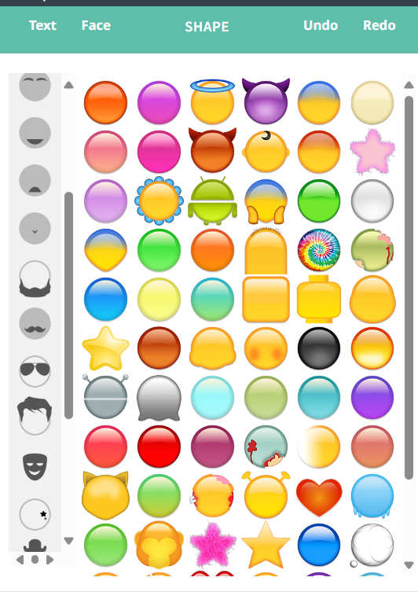

The sample of the emoji making:-

Slide 10
Project Architecture:-
Overview:
Activity/Fragment: Manages the user interface and user interactions.
Adapter: Binds data (image URIs) to the views (ImageView).
Model: Represents the data (image URIs, metadata).
ContentProvider: Used to access images from the device storage securely.
Main Components:
MainActivity: Hosts the Gallery view.
ImageAdapter: Binds image data to the RecyclerView/ GridView.
ImageViewerActivity: Displays selected image in full-screen.

Slide 11
Technologies Used:
Programming Language:
Java: Primary language for Android app development.
UI Components:
RecyclerView/GridView: For displaying images in a grid.
ImageView: To display each image in the grid.
ImagePicker: To open and display selected images.
Storage Access:
ContentResolver: For fetching images from the device storage.
External/Internal Storage Access: Using MediaStore for reading images.
Permissions:
READ_EXTERNAL_STORAGE & WRITE_EXTERNAL_STORAGE: Permissions
required for accessing photos from the device storage.

Slide 12
Technologies Used:
Libraries:
Glide/Picasso: For efficient image loading in the gallery.
Bitmap: For saving the custom emojis.
Storage Access:
ContentResolver & MediaStore: To access images from internal or external storage.

Slide 13
THANK YOU

